Slide 1

Coding using code.org/
Mr Duncan Borg

Slide 2

We are learning what a computer program is made of
Notes:
Revision from Grade 3

Slide 3
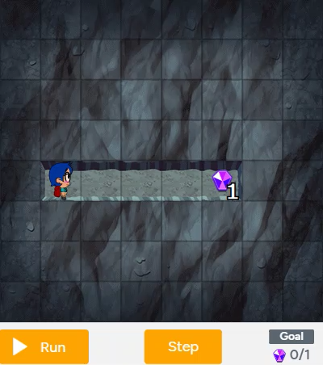
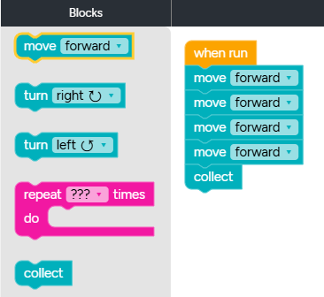
What is Coding?
Coding is to write step-by-step instructions that tell the computer what to do.
An example:
Notes:
Revision from Grade 3

Slide 4
What is a Computer Program?
A computer program is a set of instructions that the computer follows to complete a task.
An example:
Notes:
Revision from Grade 3

Slide 5
We are learning to express movements in a series of command blocks
Notes:
Revision from Grade 3

Slide 6
Code.org/
Programming with Angry Birds:
https://studio.code.org/s/coursec-2023/lessons/3/levels/1?redirect_warning=true
Notes:
Revision from Grade 3

Slide 7
We are learning to identify and locate bugs in a program
Notes:
Revision from Grade 3

Slide 8
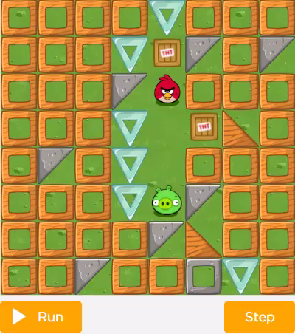
What is a Bug?
A bug is a mistake in the step-by-step instructions.
An example:
Notes:
Revision from Grade 3

Slide 9
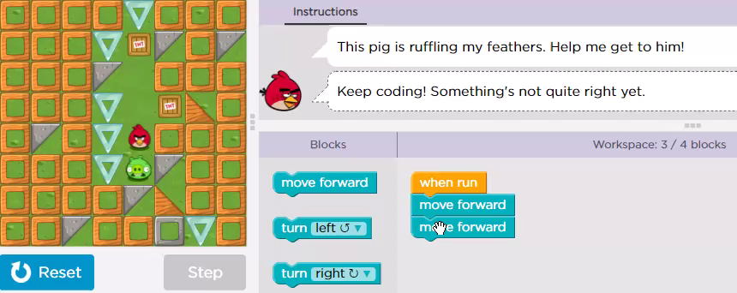
What is Debugging?
Debugging is to find and fix the mistakes in the step-by-step instructions.
An example:
Notes:
Revision from Grade 3

Slide 10
Code.org/
Debugging in a Maze:
https://studio.code.org/s/coursec-2023/lessons/4/levels/1?redirect_warning=true
Notes:
Revision from Grade 3

Slide 11
We are learning to order movement command blocks in the correct sequence
Notes:
Grade 4 – learn/consolidate coding and debugging from Grade 3

Slide 12
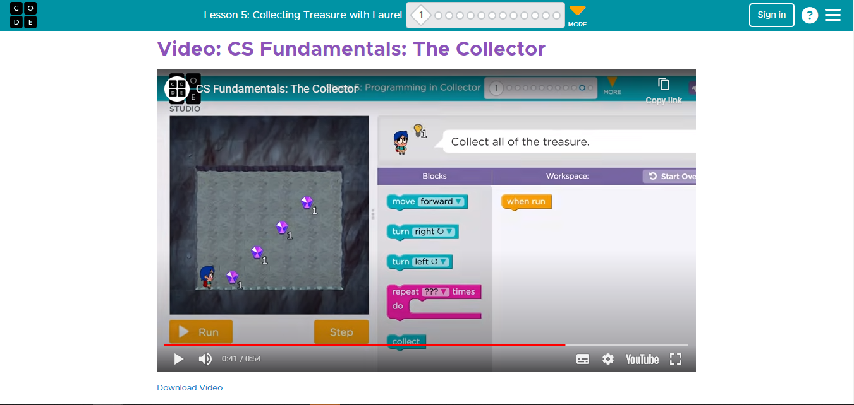
Code.org/
Collecting Treasure with Laurel
https://studio.code.org/s/coursec-2023/lessons/5/levels/1?redirect_warning=true
Notes:
Grade 4 – learn/consolidate coding and debugging from Grade 3

