Slide 1

Microsoft Teams
Mr Duncan

Slide 2
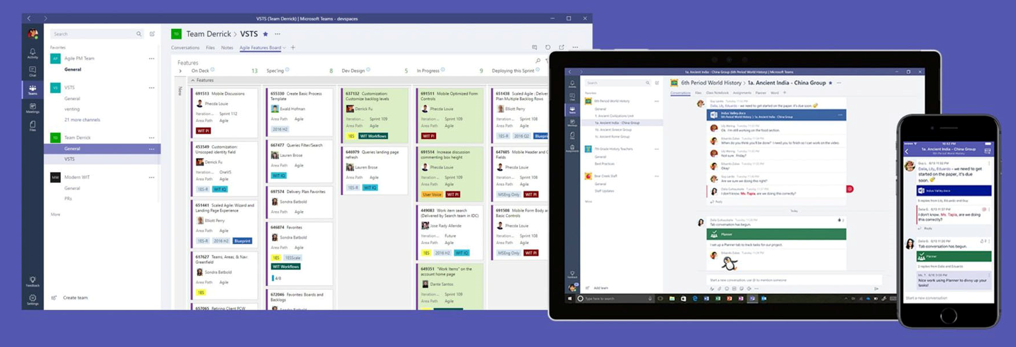
What is Microsoft Teams?
Microsoft Teams is a communication and collaboration platform that lets the users to chat, video call, post information, and send/receive work by using Assignments

Slide 3
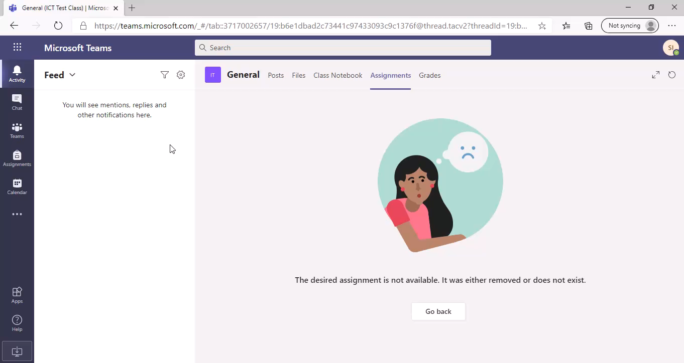
How to open a Team

Slide 4
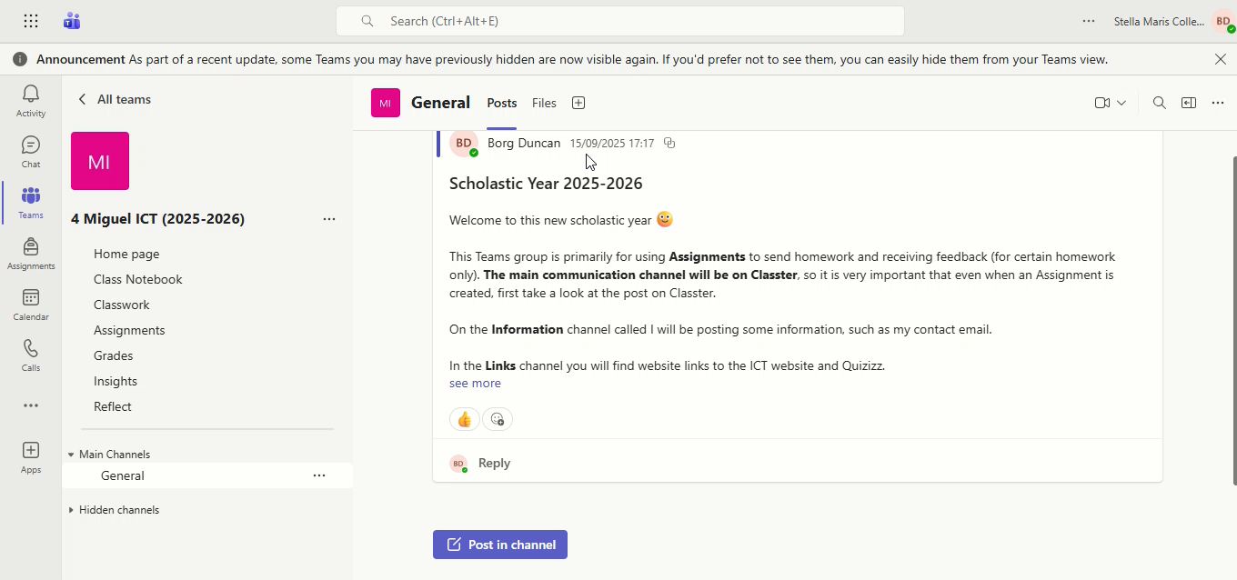
How to Show hidden Channels

Slide 5
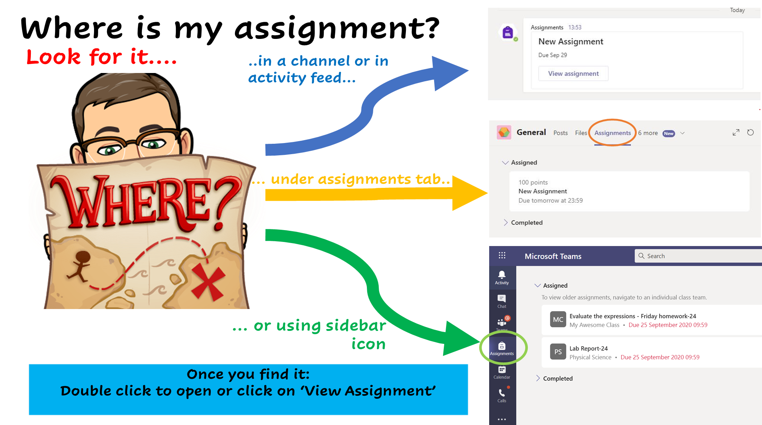
Checking for Assignments

Slide 6
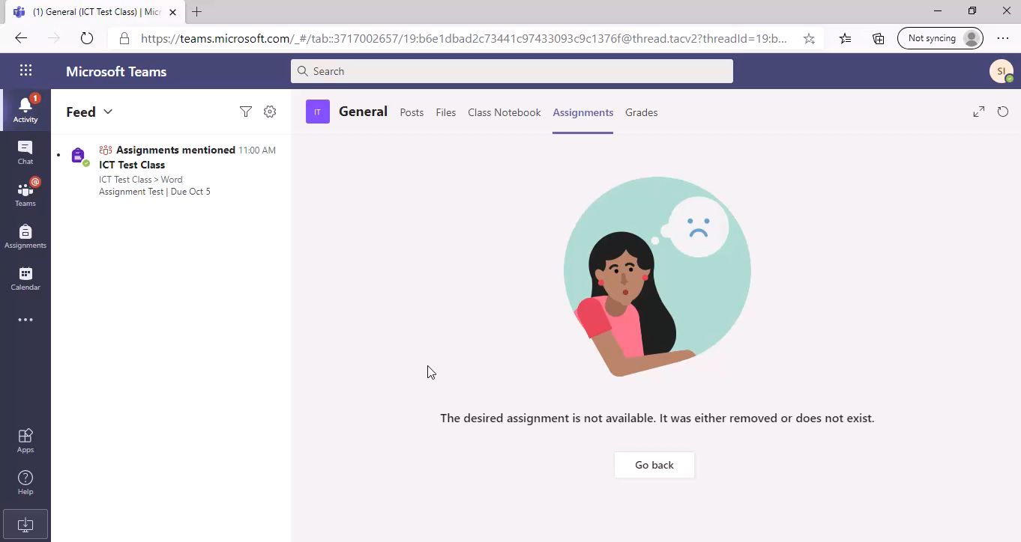
Checking for Assignments

Slide 7
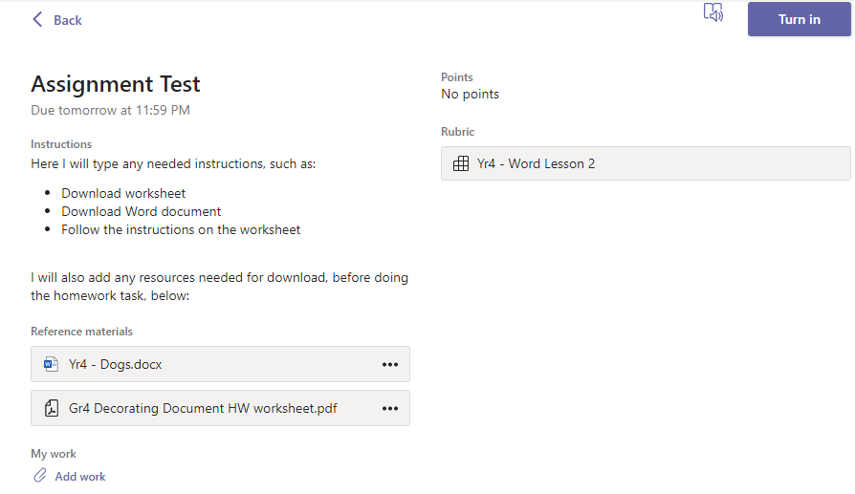
Assignment
Read the instructions
Follow the instruction worksheet and finish the task required.
You Download the material needed for the homework
After you save your work, upload it by clicking on Add work (Attach)

Slide 8
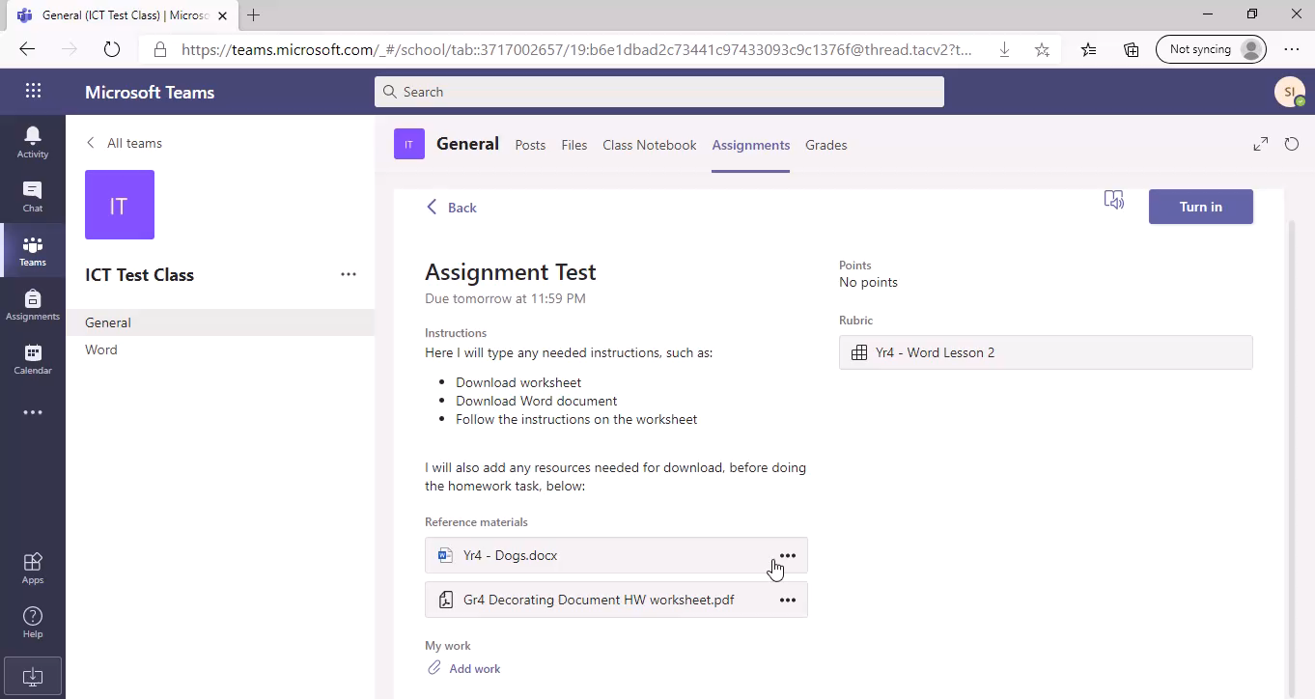
Assignment: How to download files

Slide 9

Assignment: How to add your work

Slide 10
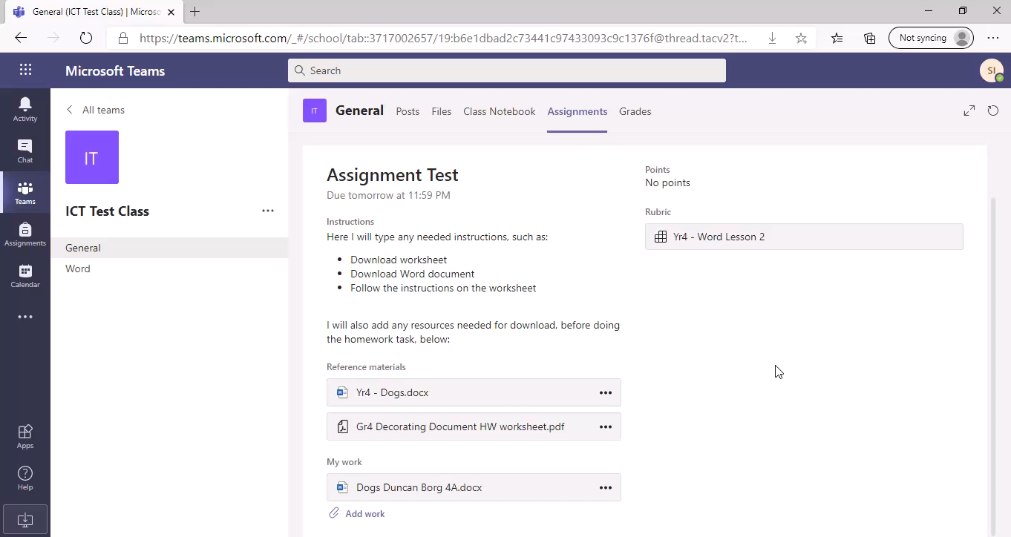
Assignment: How to Turn in your work

Slide 11
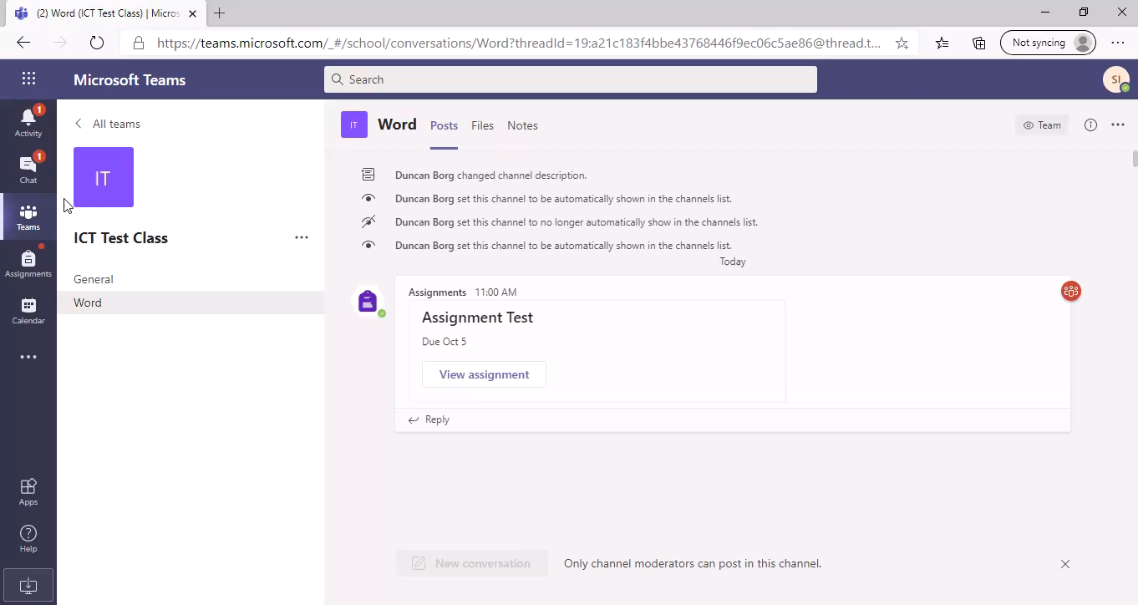
Assignment: Returned Assignment

Slide 12
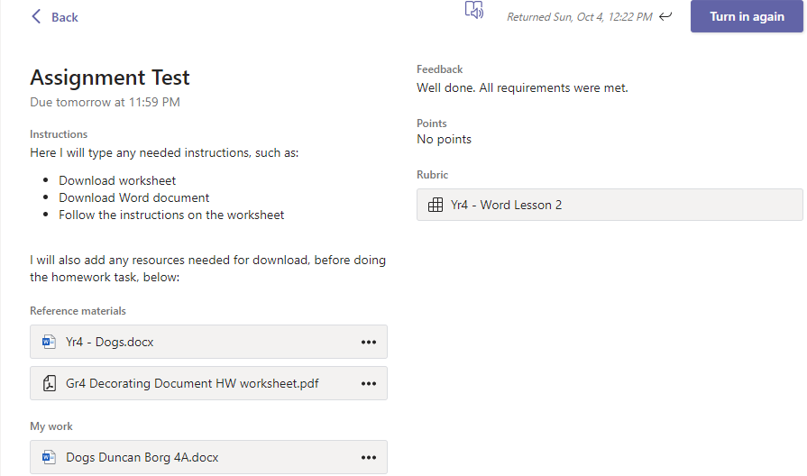
Assignment: Returned Assignment
Check Feedback given
Only Turn in again if written in the
feedback given.

Slide 13
Download App
Link: https://www.microsoft.com/en-gb/microsoft-365/microsoft-teams/download-app

