Slide 1

Coding using code.org/
Mr Duncan Borg

Slide 2

We are learning what a computer program is made of
Notes:
Revision from Grade 3

Slide 3
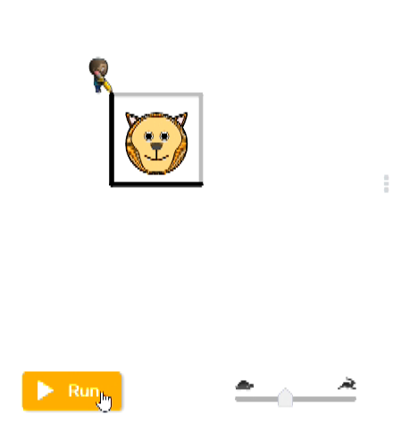
What is Coding?
Coding is to write step-by-step instructions that tell the computer what to do.
An example:

Slide 4
What is a Computer Program?
A computer program is a set of instructions that the computer follows to complete a task.
An example:

Slide 5
We are learning to break drawing
2D-shapes into a series of command blocks
Notes:
Revision from Grade 3

Slide 6

What is a Pixel?
A pixel is the smallest point of visual components on a digital image/screen.

Slide 7
Code.org/
Creating Art with Code:
https://studio.code.org/s/coursec-2023/lessons/6/levels/1?redirect_warning=true

