Slide 1

Education WeDo

Slide 2
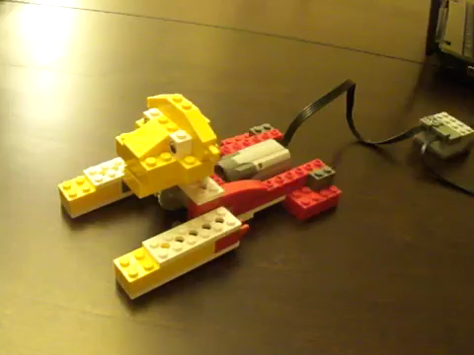
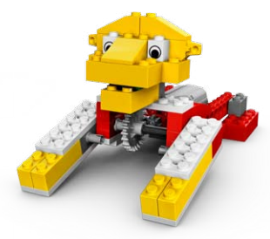
Roaring Lion

Slide 3
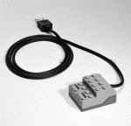
Hub
The hub connects the WeDo parts to the computer through a USB port.

Slide 4
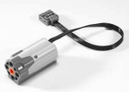
Motor
The motor makes things turn.

Slide 5
Axle
The axle connects things together.

Slide 6

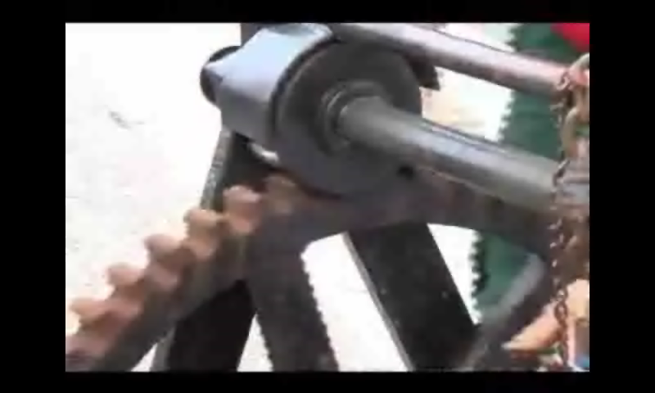


Gears
gear
small gear
crown gear

Slide 7
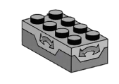
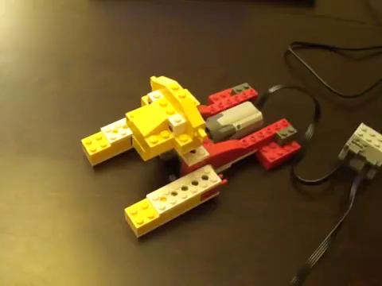
Tilt Sensor
The tilt sensor tells the computer when it is pointed up or down.

Slide 8
WeDo Software

Slide 9
WeDo Software Interface
Close
Connection Tab
Open Project
New Project
Project Name
Content Tab
Stop Program
Blocks Palette

Slide 10











Instruction Blocks
start program
start on key press
wait for…
repeat for…
tilt shake
turn motor clockwise
turn motor anti-clockwise
set motor speed
motor on for…
motor off
play sound

