Slide 1
Introductions
ICT Lesson 1

Slide 2
About
Me

Slide 3
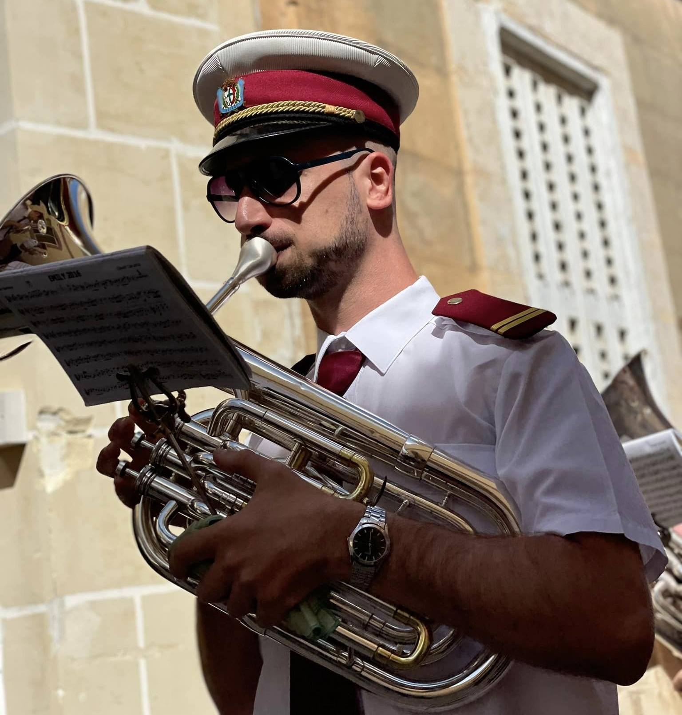
Personal Information
My name is Mr Duncan Borg
I am 35 years old
I live in Żejtun
I play the althorn with Band Clubs

Slide 4
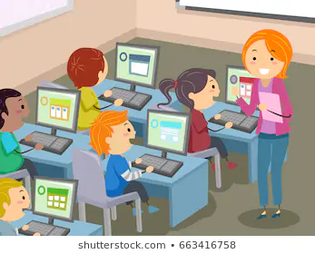
Teaching Information
9th year of teaching
I am going to teach you ICT

Slide 5
I.C.T.

Slide 6
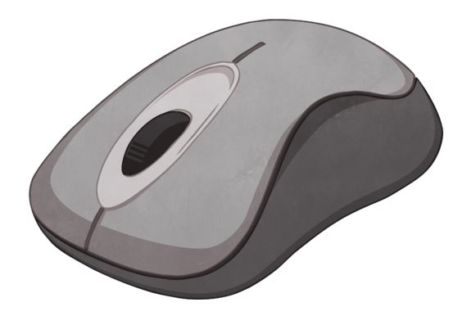
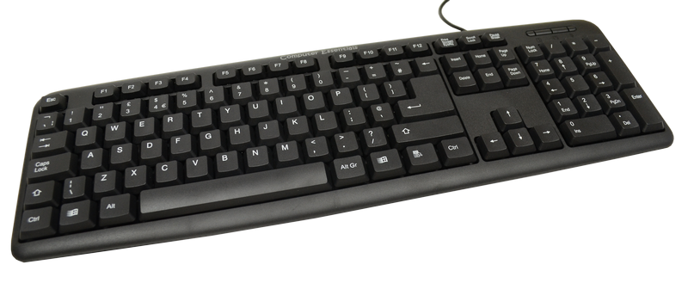

We are going to learn…
how to use the mouse
how to use the keyboard
about computers

