Slide 1

Education WeDo

Slide 2
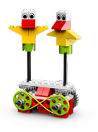
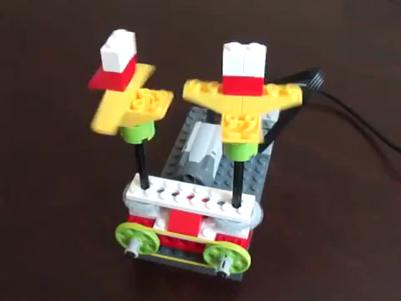
Dancing Birds

Slide 3
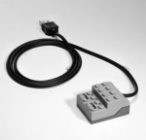
Hub
The hub connects the WeDo parts to the computer through a USB port.

Slide 4
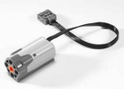
Motor
The motor makes things turn.

Slide 5
Axle
The axle connects things together.

Slide 6



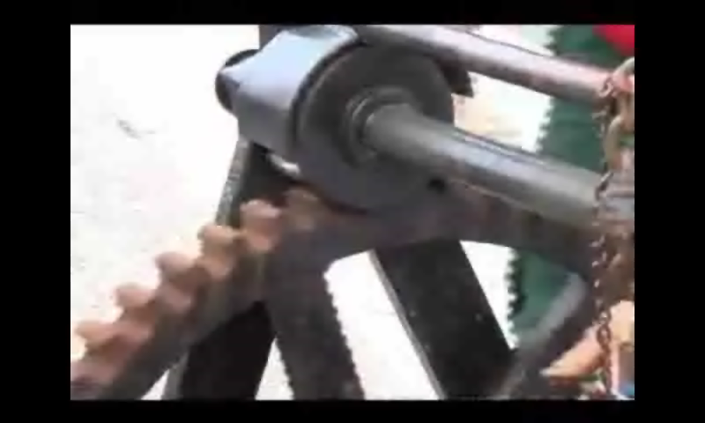
Gears

Slide 7
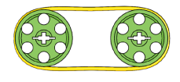
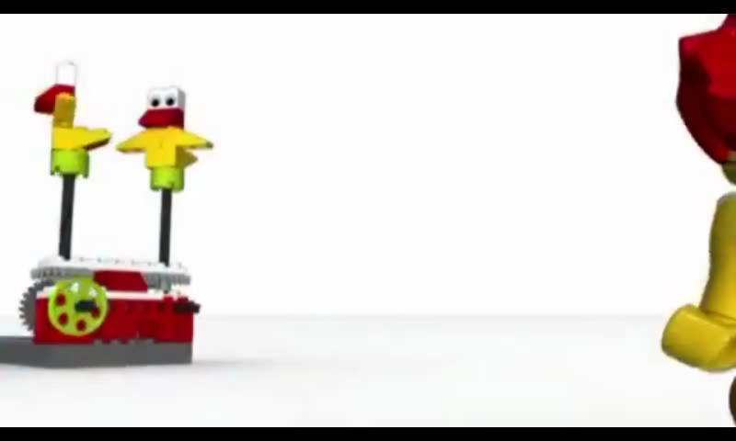
Pulleys and Belt
wheel
belt

Slide 8
WeDo Software

Slide 9
WeDo Software Interface
Close
Connection Tab
Open Project
New Project
Project Name
Content Tab
Stop Program
Blocks Palette

Slide 10







Instruction Blocks
start program
turn motor clockwise
turn motor anti-clockwise
set motor speed
motor on for…
motor off
play sound

