Slide 1
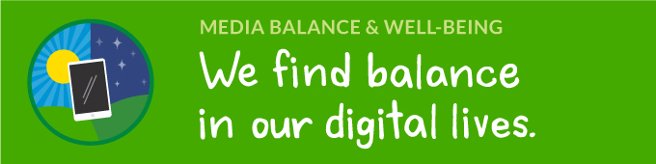
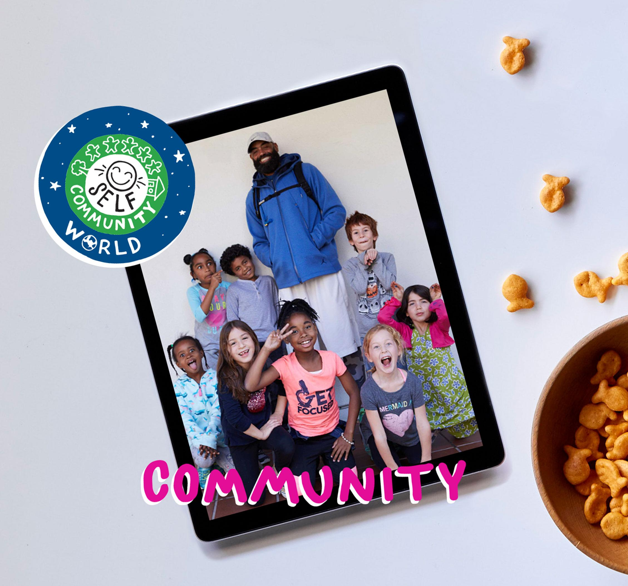


DIGITAL CITIZENSHIP
UK YEAR 4 (AGE 8-9)
Your Rings of Responsibility

Slide 2

Essential Question
How do good digital citizens take responsibility
for themselves, their communities, and their world?

Slide 3

Learning Objectives
l
Examine both online and in-person responsibilities.
Describe the Rings of Responsibility as a way to think about how our behavior affects ourselves and others.
Identify examples of online responsibilities to others.
2
3

Slide 4

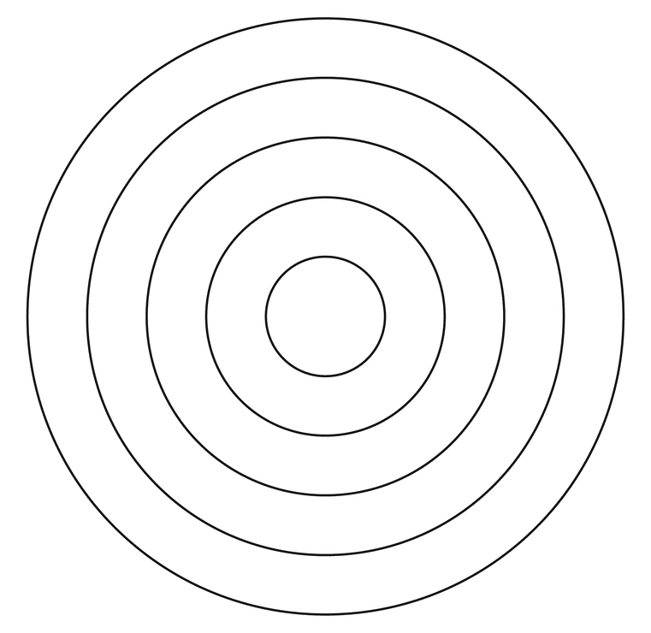

WARM-UP
Notes:
Before the lesson: Use masking tape to create a large, physical version of the Rings of Responsibility on your classroom floor. Alternatively, you can create the rings with chalk on the ground in the playground.
Invite your learners to gather around you.
Drop a pebble or a penny into a bowl of water and watch the concentric circles ripple on the surface.
Ask: What do these circles remind you of?
Learners may respond with: a bull's eye, rings in a tree stump, etc..
Explain that the circles remind you of the Rings of Responsibility.

Slide 5

KEY VOCABULARY
Responsibility
A duty you have to yourself or others
Notes:
Clarify that a responsibility is a duty you have to yourself or others. (Slide 4)

Slide 6


WATCH + DISCUSS
Discuss:
How could throwing a bottle out of your window be similar to something you do online?
Answer
Notes:
Show the Rings of Responsibility video on Slide 5 and ask: According to the video, how could throwing a bottle out of your window be similar to something you do online? Take turns sharing with your partner.
Invite learners to respond.
Clarify that littering is similar to doing something online, because they both show how your actions affect not only you, but also your community and your world.
Ask: According to the video, what are the Rings of Responsibility?
Invite learners to respond.
Clarify that each ring represents a person or group you are responsible to (yourself, your community and your world) and that being responsible to someone means that you think about how your actions will impact them.

Slide 7

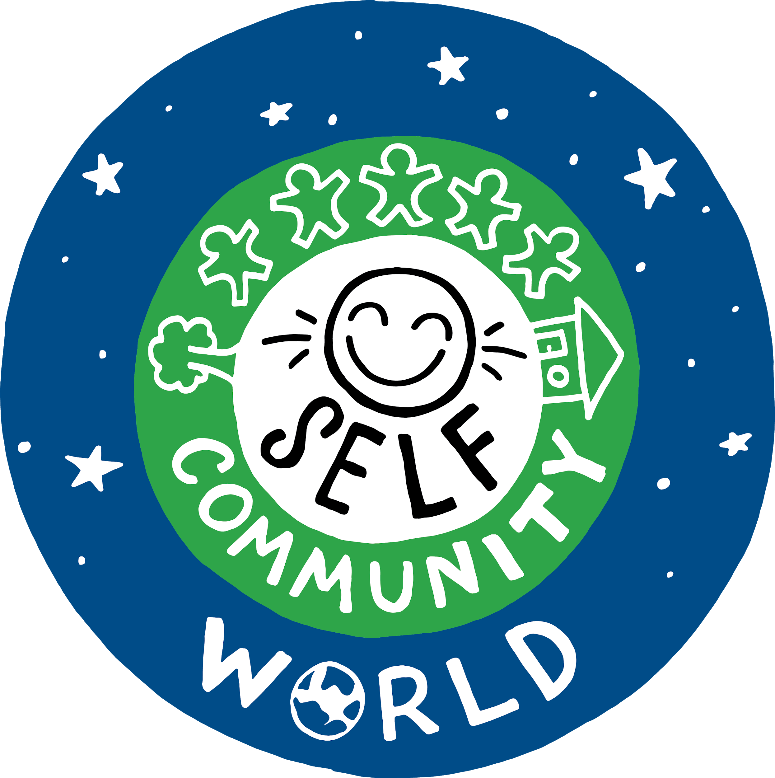
OBSERVE + ANALYZE IMAGE
The Rings of Responsibility
SELF
COMMUNITY
WORLD
Notes:
Show learners the Rings of Responsibility framework on Slide 6 and explain what each ring represents:
Self: The centre ring represents responsibilities you have to yourself, such as keeping yourself safe and healthy.
Community: The middle ring stands for responsibilities you have to your community, including the people you know and interact with on a regular basis. This can include both friends and family. It can also include people you don't know well, but with whom you interact with (e.g. shop assistants, a friend in an online gaming community, etc.).
World: The outer ring stands for your responsibilities to the larger world. This would include people you don't know, but whom your actions might affect. (If necessary, define the vocabulary term community.)

Slide 8
OBSERVE + ANALYZE IMAGE
The Rings of Responsibility
What responsibilities do you have to yourself?
What responsibilities do you have to your community?
What responsibilities do you have to your world?
Notes:
Pair learners up and assign each to be A, B or C. Have each pair answer one of the questions on Slide 6, according to their letter.
Call on pairs to share their answers.
Example answers might include:
Self: I eat healthy food / I keep my bedroom clean / I don't watch too much TV before bed.
Community: I help my neighbours with gardening / I follow rules like using the zebra crossing.
World: I don't litter / I don't say mean things to others online.

Slide 9
KEY VOCABULARY
Digital Citizen
Someone who uses technology responsibly to learn, create, and participate
Notes:
Ask: Have you ever heard the term "digital citizen"? What comes to mind when you hear that term?
Invite learners to share any words or ideas that come to mind.
Clarify that a digital citizen is someone who uses technology responsibly to learn, create and participate. (Slide 7)
Say: As digital citizens, we have responsibilities to ourselves, our communities and our world as we learn, create and participate on the internet.

Slide 10
OBSERVE + ANALYZE IMAGE
The Rings of Responsibility
Which ring am I? – Self, Community or World
I only use apps and websites that are OK for someone my age.
Answer
I never share things about my friends that they wouldn't want other people to know.
Answer
Notes:
Read the following statements aloud, pausing after each one, so learners have time to move around.
If you have time, discuss and reflect when learners have different answers.
Some examples may fit into multiple rings.
I only use apps and websites that are OK for someone my age. (Self)
I never share things about my friends that they wouldn't want other people to know. (Community)
I don't post or share information online if I'm not sure that it's true. (World)
I treat others with respect, in person or online. (Community or World)

Slide 11
OBSERVE + ANALYZE IMAGE
The Rings of Responsibility
Which ring am I? – Self, Community or World
I don't post or share information online if I'm not sure that it's true.
Answer
I treat others with respect, in person or online.
Answer

Slide 12

ACTIVITY: MY RINGS OF RESPONSIBILITY
Directions
First, choose three colors and use them to color in the key.
Then, use the key colors to color in the correct ring or rings for each statement.
Notes:
Read the directions aloud and hand out crayons, coloured pencils or markers. (Slide 8)
Allow five to seven minutes for learners to complete the handout.
Invite learners to share out their answers. (See the Teacher Version for reference.)
Invite learners to select one statement from the handout and write an explanation for which ring(s) it belongs in and why.
They can write this either on the back of the handout or by adding a second page to the document.

Slide 13
