Slide 1





DIGITAL CITIZENSHIP
UK YEAR 3 (AGE 7-8)
That's Private!

Slide 2
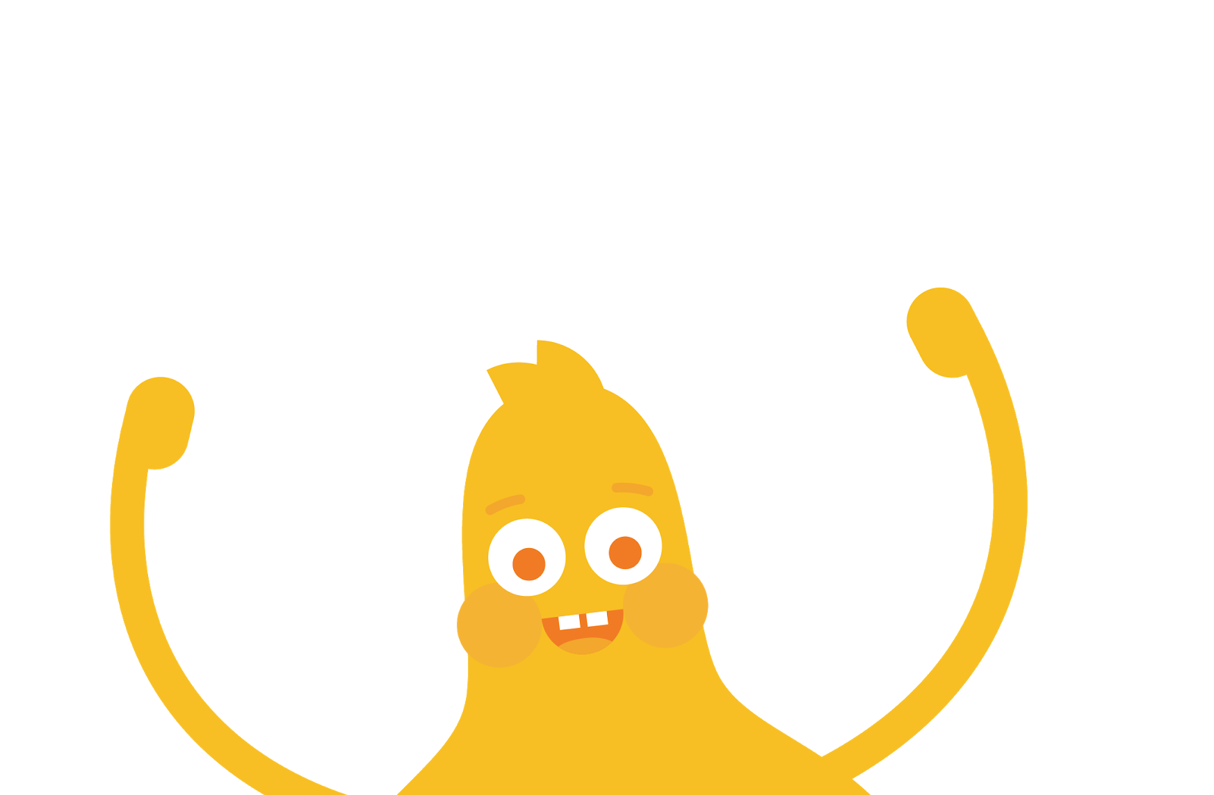

What kinds of information should I keep to myself when I use the internet?

Slide 3



WARM UP
What kinds of things should we not tell a stranger?
Answer
Notes:
Ask: What kinds of things should we not tell a stranger? (Slide 3)
Invite learners to respond.
Answers may vary, but highlight things like address, phone number, full name, etc..

Slide 4

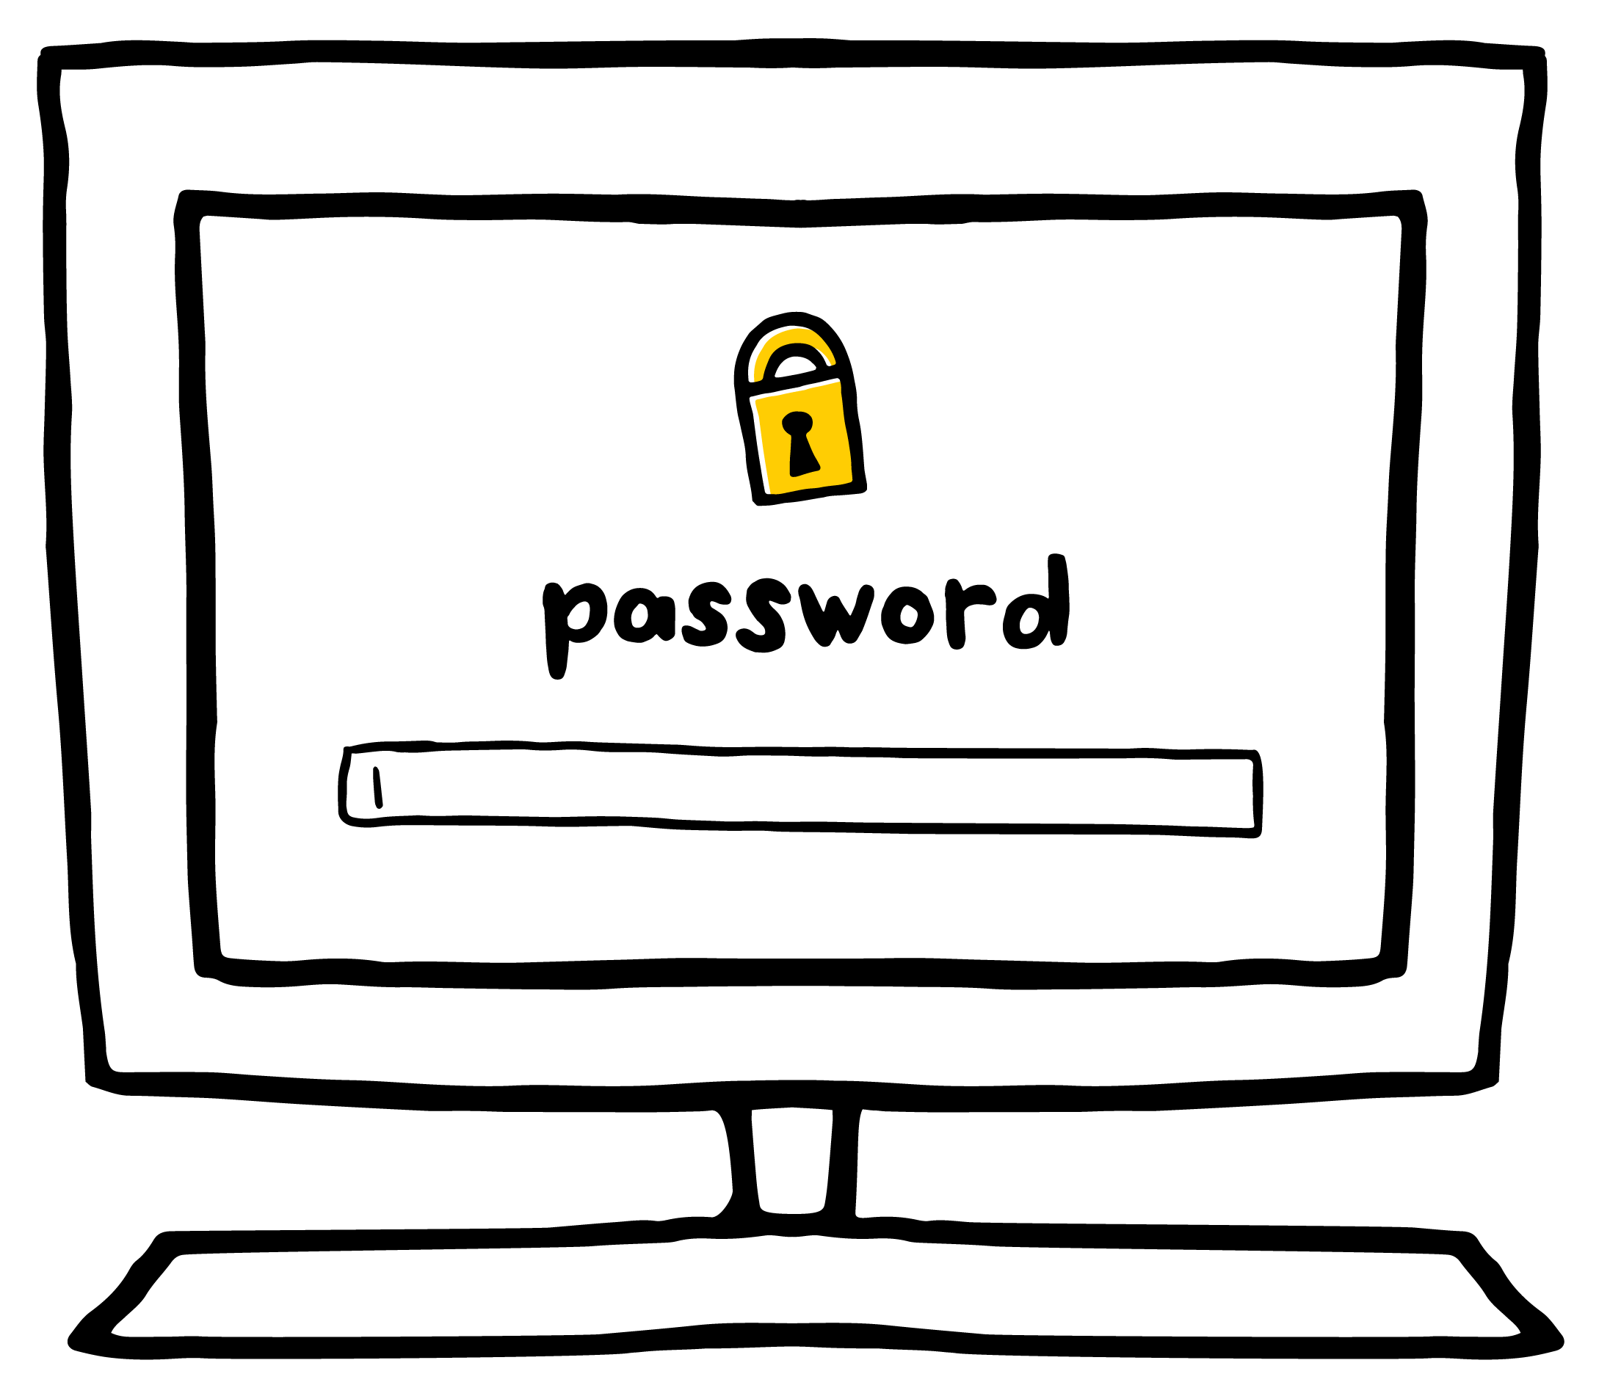

KEY VOCABULARY
Private
Something that you should
keep to yourself
Notes:
Say: It is important for you to keep certain information about yourself, like your address and phone number, private from strangers.
Project Slide 4 and define private as something that you should keep to yourself. It should only be shared with people you trust, like your parents or teacher.
Explain that private information is often connected to a specific person. For example, no two people in the class have the same full name and phone number.

Slide 5

REVIEW
Private Information
A picture of yourself Full Name Age Date of Birth Home Address Telephone Number Email Address Passwords Parents’ Full Names Parents’ Credit Card Numbers
Notes:
Invite learners to give examples of information that they should keep private.
Write down their responses on Slide 5 or on chart paper so that you can return to them later in the lesson.
Make sure to cover the following:
Picture
Full name
Age
Date of birth
Address
Telephone number
Email address (or parents' email address)
Passwords
Where they go to school or after school
Parents' full names
Where their parents work
Parents' credit card or bank account number
Ask: Why do you think it's important to keep this information private?
Invite learners to respond.
Reinforce that it is never safe to give out private information to people they don't know since it can be used to trick them or put them in unsafe situations.
Explain that they should always ask a parent or carer before they give out private information to anyone. This applies to people they don't know in the physical world and people online.

Slide 6
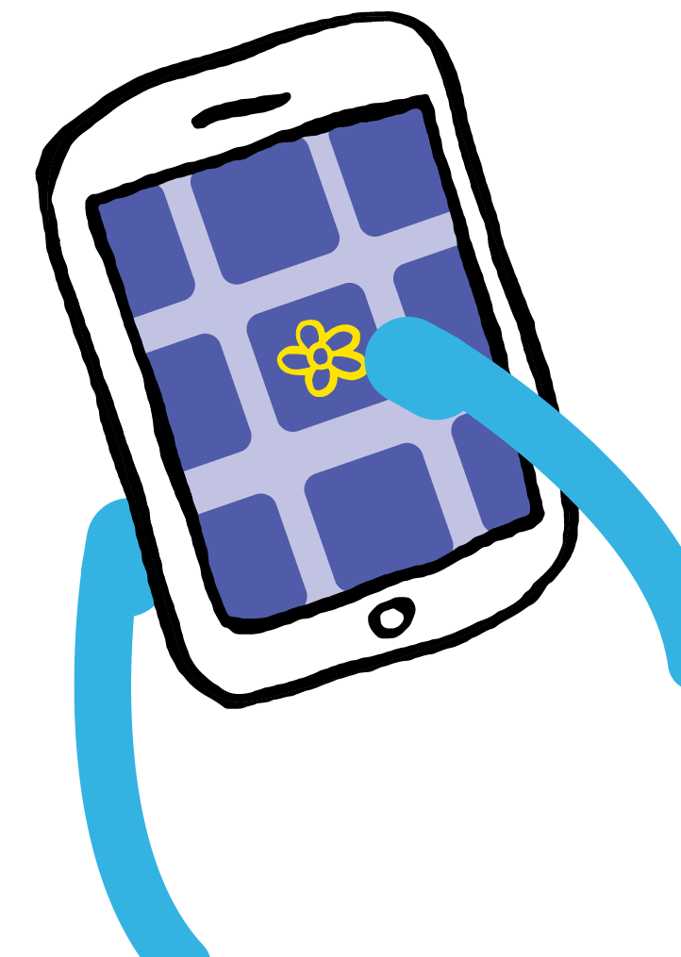
KEY VOCABULARY
Online
Using a computer, phone, or tablet to visit a website or app
Notes:
Ask: How is sharing private information online the same as telling it to a stranger in person?
Invite learners to respond.
Make sure learners understand that when they share information online, it can be viewed by people they don't know.
Project Slide 6 and define online as using a computer, phone or tablet to visit a website or app.

Slide 7


GAME
Thumbs Up, Thumbs Down
home address
Mum’s phone number
your password
favourite colour
favourite food
favourite movie
OK to share
NOT OK to share
Notes:
Say: Let's play a quick game of thumbs up, thumbs down to make sure we know what is considered private information and what isn’t.
For each example I give, think about if it is OK to share (thumbs up) or if it is something private that you shouldn't share (thumbs down) with a stranger. (Slide 7)
Your favourite ice cream flavour (thumbs up)
What you ate for dinner last night (thumbs up)
Your home address (thumbs down)
Your best friend's favourite movie (thumbs up)
Your mum's phone number (thumbs down)
Your password (thumbs down)

Slide 8

ACTIVITY
SongTube Sign-Up!
Draw an X through the sections
that ask for private information.
Complete the rest of the form.
Notes:
Distribute the Keep It Private! handout.
Say: There's a new app called SongTube that allows you to create your own music. Guts, one of the Digital Citizens, has permission to use the app, but is being asked to fill out a form first. Guts needs your help in figuring out what's OK to share. As you review the form, complete the sections that don't ask for private information and draw an X through the sections that do ask for private information. (Slide 8)
Allow learners time to complete the form and then invite them to share their answers, emphasizing the sections that were asking for private information (Teacher Version).
Ask: Have any of you seen a form like this when visiting a website or app? Why do you think websites and apps ask for this type of information? Take turns sharing with your partner.
Invite learners to share their responses.
Explain that some reasons include:
To learn more about the people who use their app.
To send messages to people who are signing up.
To sell things to those who sign up.
Emphasize that learners should never fill out forms like this on their own, unless they have permission from a parent or carer.

Slide 9




REFLECT HANDOUT
Pause & Think Moment
Draw.
What is an example of something that is OK to share online?
and
Write.
Explain why it is important to not share private information online.
Notes:
Say: Today we talked about what information is private and why we shouldn't share it online. Now let's reflect on what we learnt. First, I'd like you to turn to your partner and share something about yourself that you don't think your partner knows about you, but that is not considered private information.
Direct learners to page two of the Keep It Private! handout.
Read the directions and allow learners to complete the activities. (Slide 9)
Invite learners to share their answers with the class. Collect the handouts to assess learning.

