Slide 1

Coding using code.org/
Mr Duncan Borg

Slide 2

We are learning what a computer program is made of

Slide 3
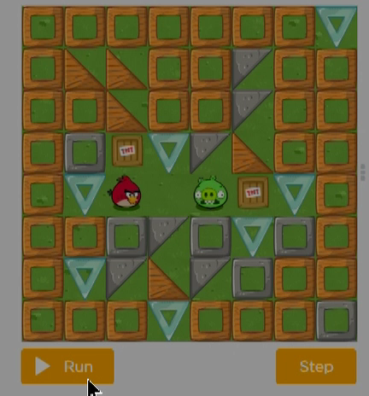
What is Coding?
Coding is to write step-by-step instructions that tell the computer what to do.
An example:

Slide 4
What is a Computer Program?
A computer program is a set of instructions that the computer follows to complete a task.
An example:

Slide 5
Code.org/
Programming with Angry Birds:
https://studio.code.org/s/coursec-2023/lessons/3/levels/1?redirect_warning=true

