Slide 1

Managing Emails by using Office 365
Mr Duncan Borg

Slide 2
We are learning to use our Microsoft Account for Office 365

Slide 3





What is Office 365?
Office 365 is an internet-based service provided by Microsoft
Office 365 provides access to online services such as:
  Outlook
  OneDrive
  Teams
  Word
  PowerPoint

Slide 4
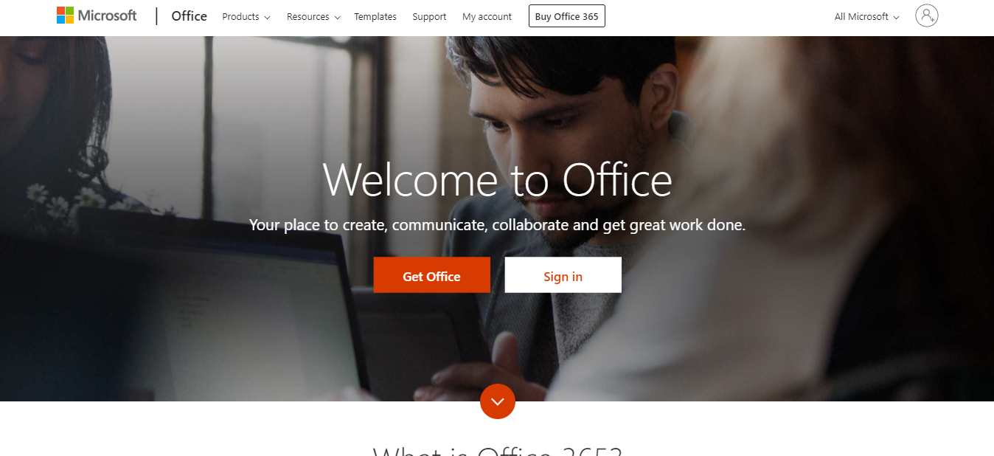
https://www.office.com/

Slide 5
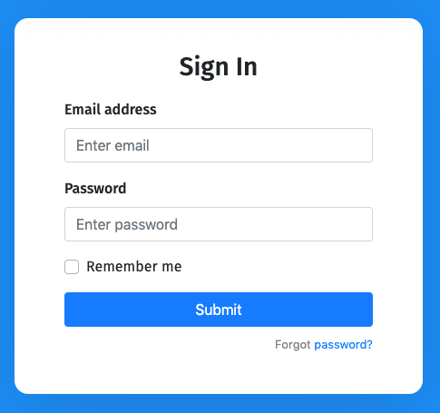

Sign in
To sign in you need an account
An account has 2 parts:
  Email address: an address belonging to one person
  Password: a secret word that only certain people know

Slide 6
What is an email address?
An email address is a string of characters that identify an electronic mailbox
An email address has 3 parts:
  username
  @
  domain name
timothy.galeaargento@smcstudents.edu.mt
domain name
username

Slide 7
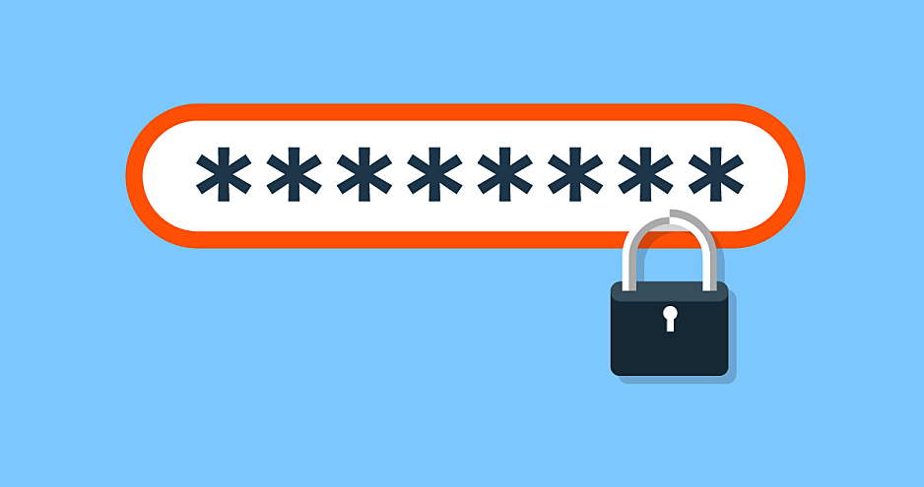
What is a password?
An password is a secret string of letters, symbols and numbers
that you can use to limit who can access something digital

Slide 8
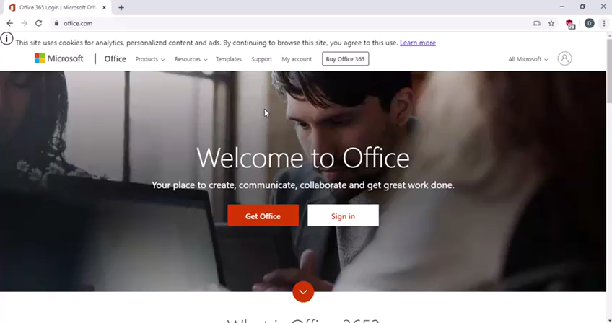
Log-in to Office 365

Slide 9
First Time Login
First time Login using a temporary password
https://dbor90.wixsite.com/smcict/office-365-first-time-login

Slide 10

We are learning to use Emails

Slide 11
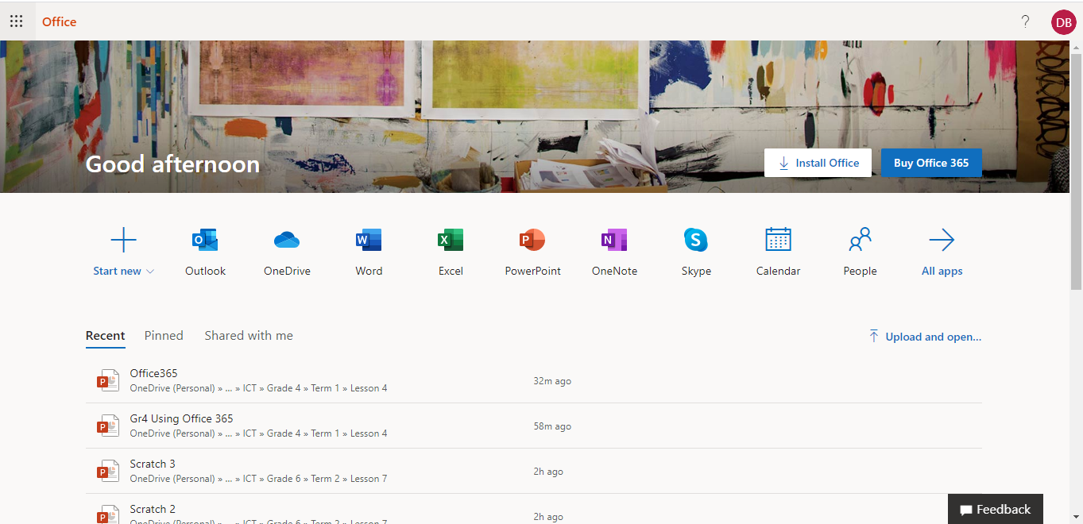
Open a Microsoft App
App Launcher

Slide 12
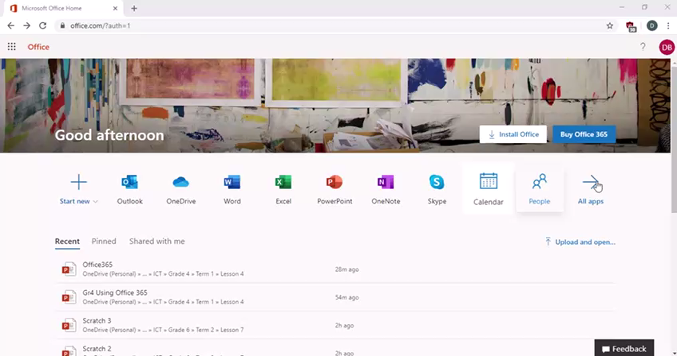
Open Outlook

Slide 13


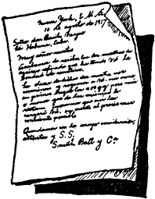
What is Outlook?
Outlook is an email service provided by Microsoft
Outlook lets you send and receive emails
What is an email?
An email is a message sent over the internet to another person.
The structure of an email is similar to letter writing.

Slide 14
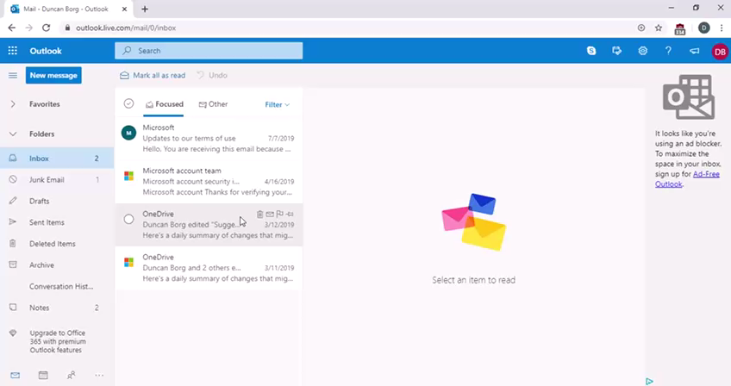
Inbox
Here you find all the received emails
Here you can read emails

Slide 15
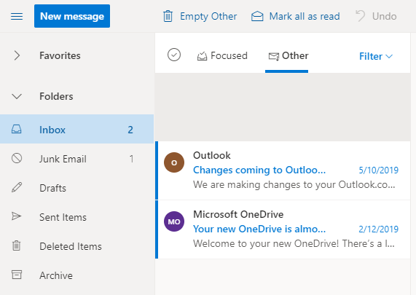
Inbox: Unread Messages
Unread messages are shown in bold
Number of unread emails

Slide 16
Reading Emails
https://dbor90.wixsite.com/smcict/outlook-inbox

Slide 17
Emails
Junk Emails are unwanted emails,
e.g. scam emails
Draft Emails are the saved emails you are writing but did not send yet
Sent Items are emails that you sent

Slide 18
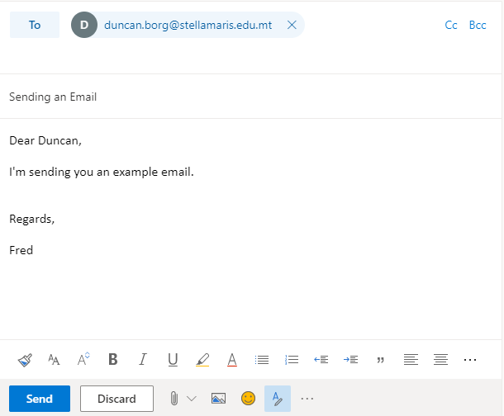
Email Structure
Here you need to type the email/s of the person/s you are sending the email to
Subject: the title for your email
Greeting: how you are going to address the person receiving your email
Skip 1 line
Body: the information or message that you want to write
Skip 2 lines
Skip 1 line
Signature: how you are going to
end (sign-off) your email
Discard: delete the draft email that you are writing
Send email button

Slide 19
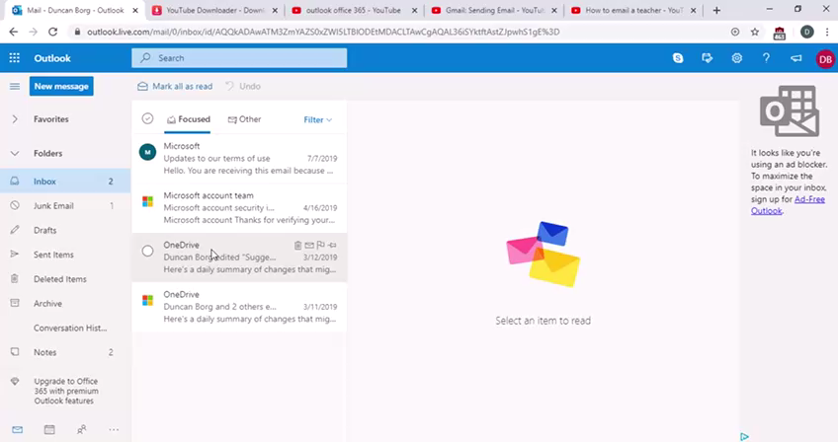
Writing a New Email

Slide 20
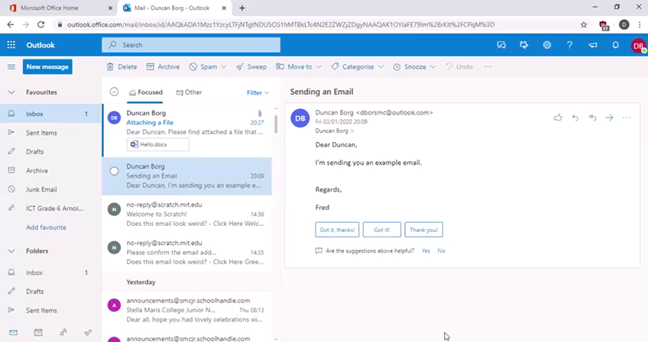
Reply to an Email

Slide 21

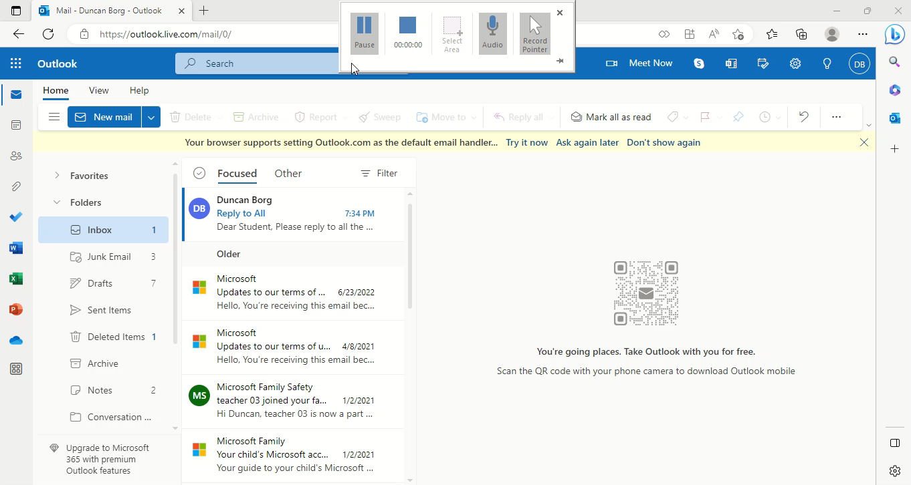
Reply All to an Email

Slide 22
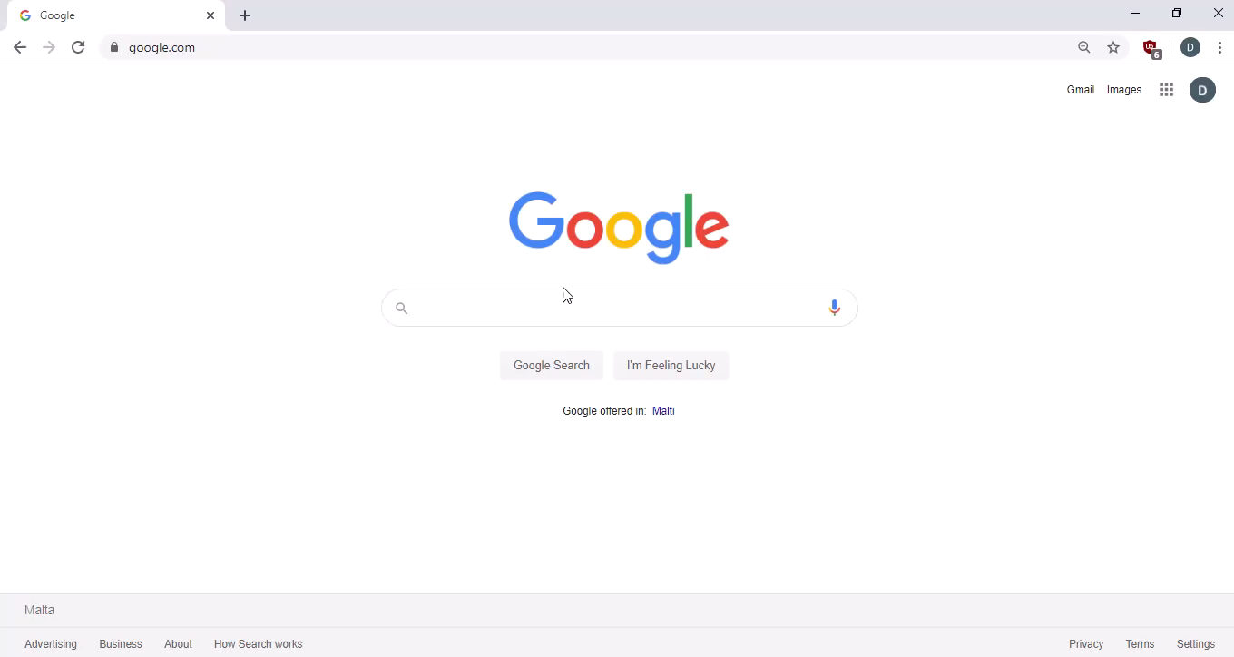
Search, Download and Save an Image

Slide 23
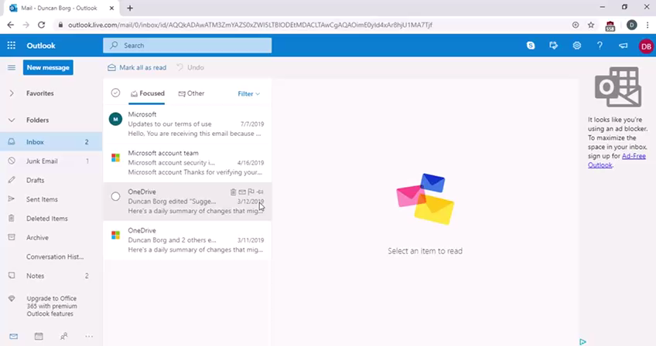
Attach a File

Slide 24

Delete and Move Emails

Slide 25
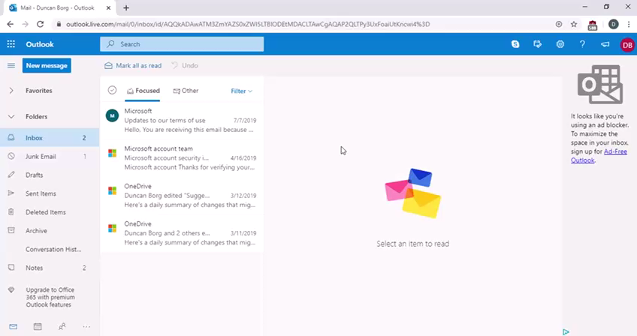
Sign Out

