Slide 1

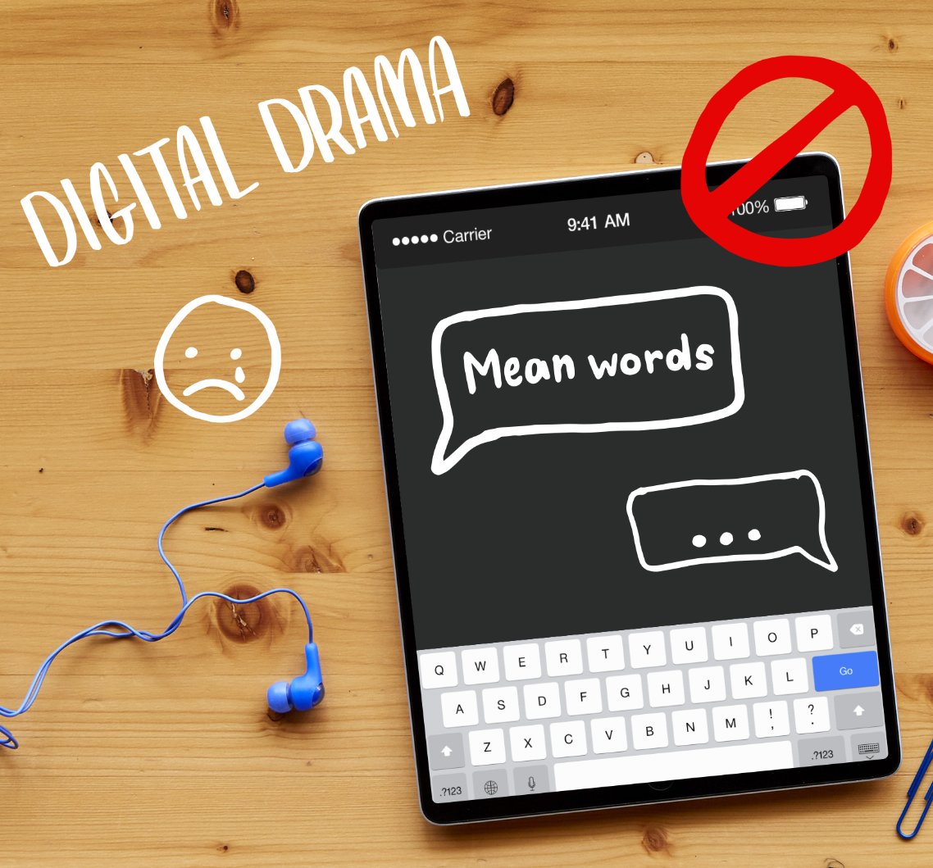


DIGITAL CITIZENSHIP
UK YEAR 4 (AGE 8-9)
The Power
of Words

Slide 2

Essential Question
What should you do when someone uses mean or
hurtful language on the internet?

Slide 3

Learning Objectives
l
Understand that it's important to think about the words
we use because everyone interprets things differently.
Identify ways to respond to mean words online, using S-T-O-P.
Decide what kinds of statements are OK to say online
and which are not.
2
3

Slide 4





WARM UP: CLASS DISCUSSION
Which emoji fits?
1
2
3
4
Notes:
Project Slide 4 and ask learners: Imagine when you walked in, I said to you [in a friendly tone, with a big smile] "Hello!". Which emoji would fit?
Have learners show their answer by holding up fingers (1, 2, 3 or 4). If anyone holds up a number other than 1, ask them to share why.
Repeat this two more times, saying "Hello!" differently each time: once with an angry tone and a scowl, and once with a nervous or scared tone.

Slide 5
WARM UP: CLASS DISCUSSION
Hello.
1
2
3
4
Notes:
Project Slide 5 and ask: What about if you're just reading it? How does it make you feel now?
Point out how when something is just in text, it can be even more difficult to interpret what someone means. Explain that their responses might be different depending on who they are, because we all interpret the world a little differently.

Slide 6


KEY VOCABULARY
Interpret
To understand something based on your point of view
Notes:
Clarify that interpret means to understand something based on our point of view. (Slide 6)
Say: Because words can be interpreted differently by different people, it's important to think about the words we use and how they affect people.
We might say something just to be funny, but someone might take it seriously and it might hurt their feelings.
This can happen in person and it can also happen online.
It may even happen more online, because the words are just text -- we're not actually face-to-face with other people.

Slide 7


WATCH + ANALYZE
Power of Words
What does this video say about the saying "Sticks and stones may break my bones, but words can never hurt me"?
Notes:
Ask: Who has heard of the saying, "Sticks and stones may break my bones, but words can never hurt me"?
Invite learners to respond.
Answers will vary. Follow up by asking learners if they think the saying is true.
Project Slide 7 and say: We're going to watch a video now called "The Power of Words". As we watch, continue to think about whether that statement is true or not.
Show the video The Power of Words and then ask learners to share what it says about whether the statement is true or not.
Emphasize that sometimes it is hard to ignore what someone is saying when it's a mean name.
Names CAN make you feel sad or hurt.

Slide 8
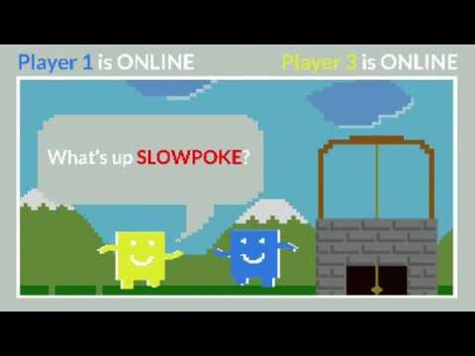
WATCH + ANALYZE
Power of Words
Why do you think those other players said those things to Guts?
Answer
What does Guts do in response to the mean words?
Answer
To watch this video on the Common Sense Education site, click here.
Notes:
Ask: Why do you think those other players said those things to Guts? (Slide 8)
Invite learners to respond.
Answers will vary, but possible reasons may include:
They were trying to joke around.
They feel badly themselves and are taking it out on someone.

Slide 9
KEY VOCABULARY
Empathy
To imagine the feelings that someone else
is experiencing
Notes:
Define empathy as to imagine the feelings that someone else is experiencing. (Slide 9)

Slide 10

Step away.
Tell a trusted adult.
OK sites first.
Pause and think online.
Notes:
Project Slide 10 and review the acronym S-T-O-P for responding to mean words online.

Slide 11

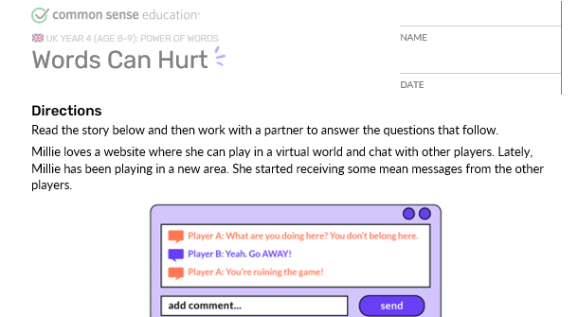
INVESTIGATE
What’s the Problem?
Notes:
Distribute the Words Can Hurt handout and read the directions out loud.
Allow pairs five minutes to complete the activity.
Invite pairs to share their answers. Refer to the Teacher Version for possible responses.

Slide 12
WRAP-UP: CROSSING THE LINE
Crossing the Line: Directions
For each statement that is read, think about whether it would be OK
or Not OK to send that as a message to someone in a video game or
as a comment.
After you decide:
  If you think it's OK, move to or stay on the OK side.
  If you think it's Not OK, move to or stay on the Not OK side.
  If you're not sure, stand on top of the line.
Be prepared to share why you chose the side you did.
Notes:
Place a string across the length of the classroom.
Mark one half of the room -- OK. Mark the other half -- Not OK.
Have learners all stand on the OK side of the line.
Project Slide 11 and read the directions aloud.

Slide 13
WRAP-UP: CROSSING THE LINE
"You are an idiot."
Notes:
Have learners read the statements on Slides 12-16.
After each statement, allow time for learners to move or stay.
Call on learners to explain their thinking. If possible, choose learners from each side to debate reasons why the statement is or isn't ok.
For the examples where learners say it's Not OK, follow up by asking them what they could do if they received that message from someone.

Slide 14
WRAP-UP: CROSSING THE LINE
"I'm having a party and
you're not invited."

Slide 15
WRAP-UP: CROSSING THE LINE
"I like your new haircut."

Slide 16
WRAP-UP: CROSSING THE LINE
"Thanks for the advice. Next
time, would you mind telling me in
person rather than by texting?"

Slide 17
WRAP-UP: CROSSING THE LINE
"Did you finish your
homework?"
Notes:
Review that children like to go online to chat, watch videos, send messages, play games and do homework.
Sometimes people say mean or scary things. Messages that make people feel bad cross the line.

Slide 18
