Slide 1

Coding using code.org/
Mr Duncan Borg

Slide 2

We are learning what a computer program is made of
Notes:
Revision from Grade 3

Slide 3
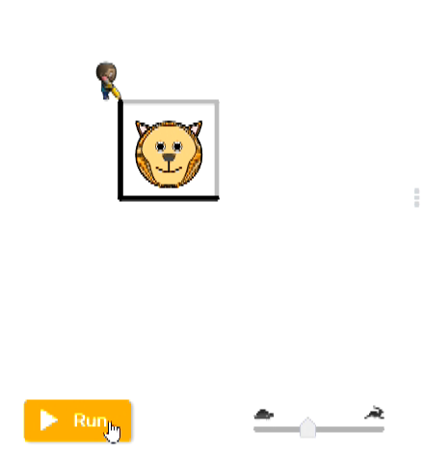
What is Coding?
Coding is to write step-by-step instructions that tell the computer what to do.
An example:

Slide 4
What is a Computer Program?
A computer program is a set of instructions that the computer follows to complete a task.
An example:

Slide 5
We are learning to identify repetitive block sequences and change them into loop commands
Notes:
Students will be able to:
Break down a long sequence of instructions into the largest repeatable sequence.
Employ a combination of sequential and looped commands to reach the end of a maze.
Identify the benefits of using a loop structure instead of manual repetition.

Slide 6
We are learning to use a combination of sequential and loop commands to solve the maze
Notes:
Students will be able to:
Break down a long sequence of instructions into the largest repeatable sequence.
Employ a combination of sequential and looped commands to reach the end of a maze.
Identify the benefits of using a loop structure instead of manual repetition.

Slide 7
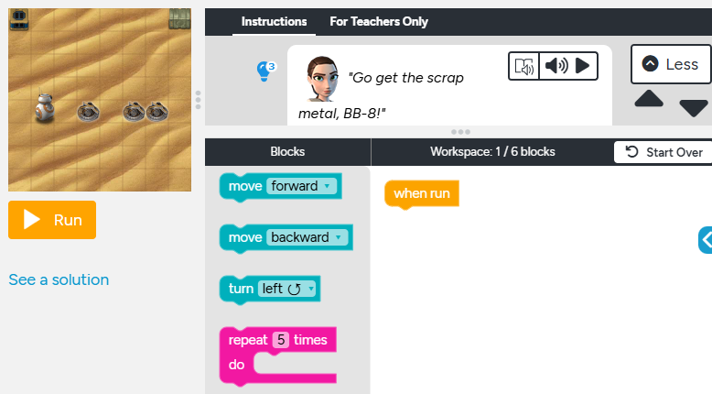
Code.org/
Loops with Rey and BB-8:
https://studio.code.org/s/coursec-2021/lessons/8/levels/1

