Slide 1
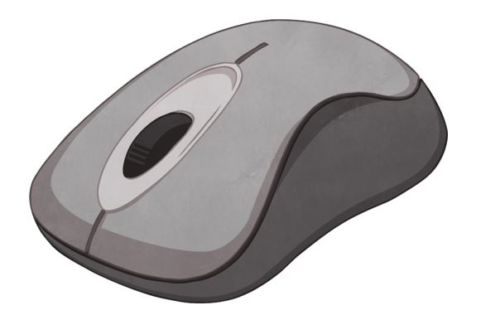
The Mouse
Mr Duncan Borg

Slide 2



Parts of the Mouse
scroll wheel
right button
left button

Slide 3
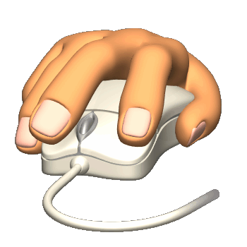
Hand Position
I put my writing hand (left or right) on the mouse.

Slide 4

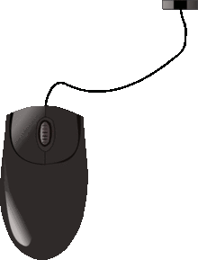
Mouse Pointer
This is the mouse pointer.
I use the mouse to move it
on the screen.

Slide 5
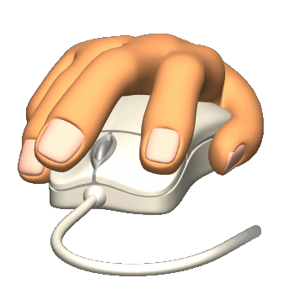
Click

Slide 6
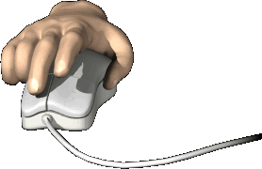
Click and Drag

Slide 7
Double-click

Slide 8
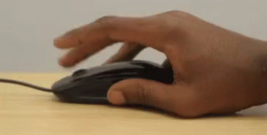
Scrolling

